Slide 1

http://taighdobhrain.co.uk/

Slide 2
Soft Skills for Success
Notes:
Also know as people skills, relationship skills
Personal skills not hard technical skills like writing queries or creating database
Its Working with those soft squidgy things that do not fit into databases
Believe me I’ve tried already !

Slide 3










Notes:
Most important slide of today
These companies make this happen
Visit them talk to them

Slide 4
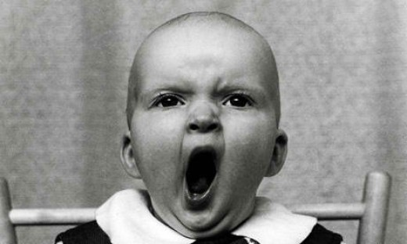
Notes:
Boring bit first

Slide 5
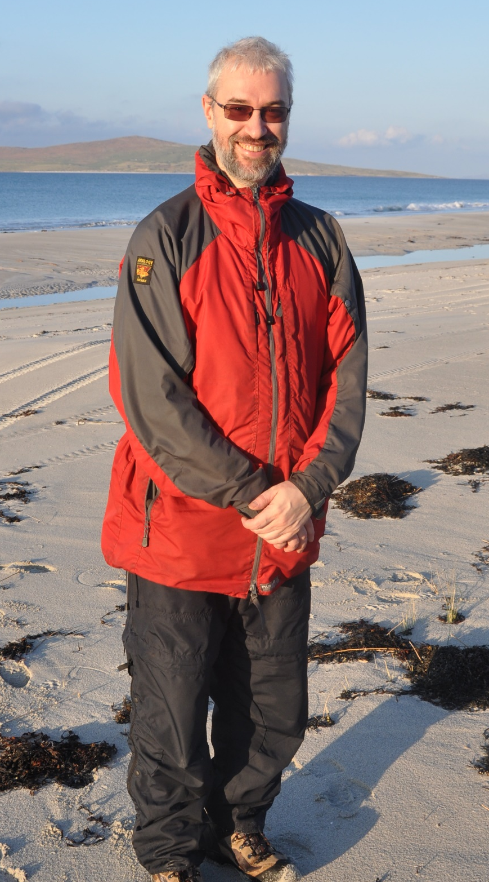




Robert French
Consultant with CC Technology
In Sunny Glasgow Scotland
rwlp.french@gmail.com
@sql_bob
https://www.linkedin.com/in/rwlpfrench/
http://www.sqlbob.uk/

Slide 6


CC Grant Tracker
CC Grant Tracker
Our home city of Glasgow
Europe’s Leading Research Grants Management System
Notes:
This is our main product we have approx. 90 % of the grant management software market in the UK

Slide 7

Selection of our Customers
Selection of our Customers

Slide 8
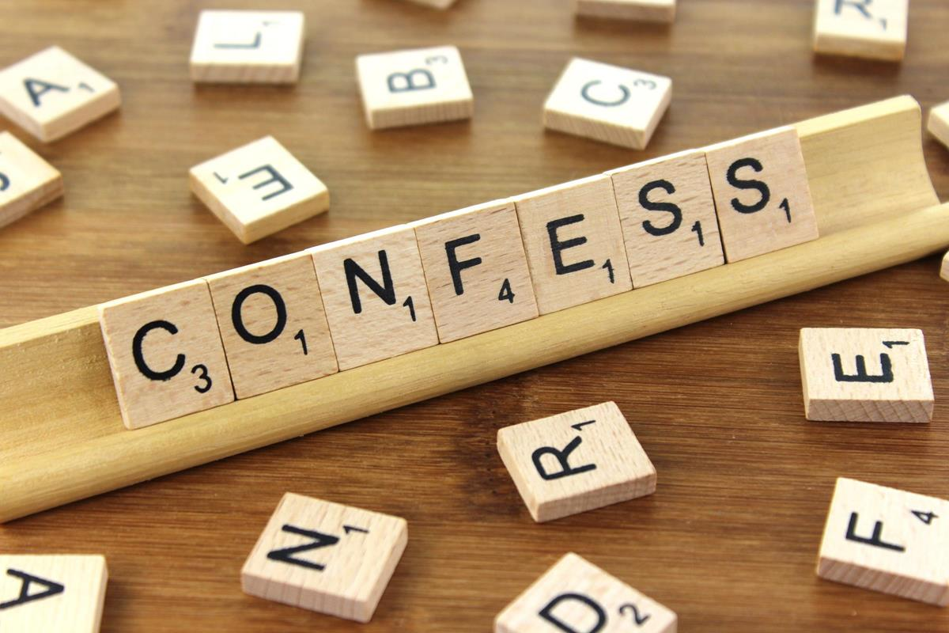
Notes:
I am dyslexic
And probably have Asperger's syndrome

Slide 9

Notes:
This will be whistle stop tour
We are going to talk about a lot of topics in a very short space of time

Slide 10

one point
Notes:
My aim with this presentation is for you to take just one point away from the session
Of your choosing
Ja enine punkt

Slide 11

Notes:
Mistakes

Slide 12

Notes:
Apologies

Slide 13
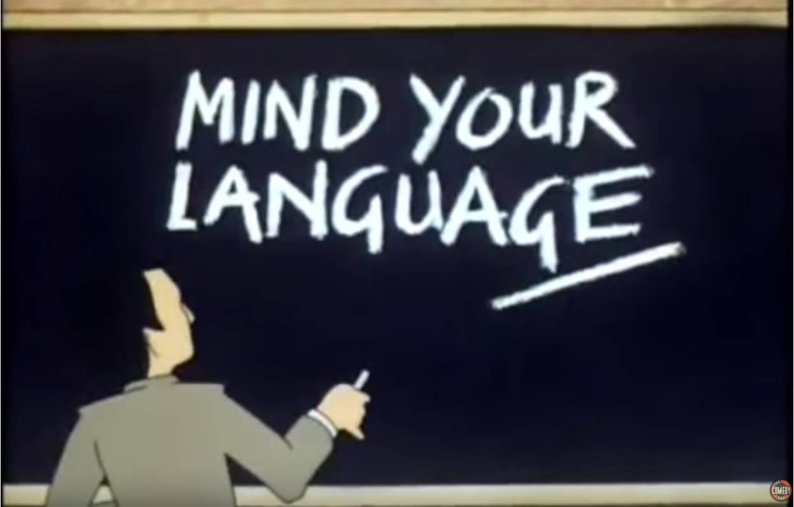
Notes:
Mind your language – what we say and how we say it

Slide 14

Notes:
Listening

Slide 15

Notes:
Pass it on – knowledge transfer

Slide 16
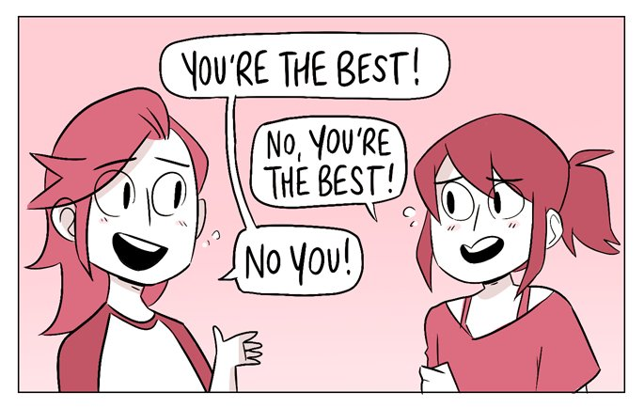
Notes:
Compliments
7 Mins

Slide 17

http://taighdobhrain.co.uk/
1 - Mistakes

Slide 18
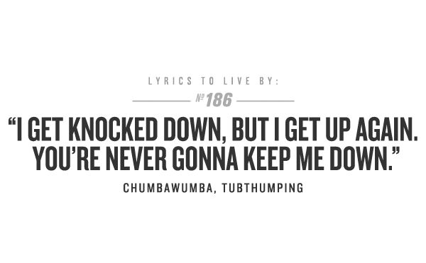
Notes:
These song lyrics remind me about the way I should look at mistakes and approach them
“I have failed my way to success”

Slide 19

Notes:
Mistakes are part of life
Learn from them
Or not learn from them
They will happened
IRW – update with a where clause on a table

Slide 20

http://cpgtoolbox.com/2015/01/16/tpm-systems-connect-corporate-planning-and-business-intelligence-to-event-level-planning/
Notes:
Share the plan that I use

Slide 21


Slide 22
Step 1

Slide 23
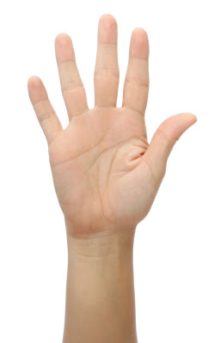
Notes:
If you made the mistake then accept responsibility
Why – better to be honest
Even if not you take responsibility to see the challenge through to end
In the case of SAIC that would be informing the users that a mistake had happened
And thanking them for point it out

Slide 24
Step 2

Slide 25
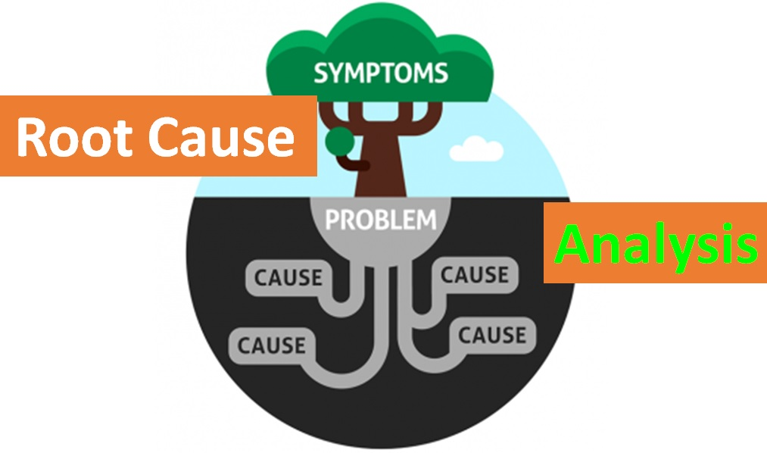
Source - https://www.foodsafety-experts.com/food-safety/powerful-root-cause-analysis/

Slide 26
Step 3

Slide 27

Notes:
A client– ran script deleted 200k + records checked with everyone – backup database
Client then point out deleted too much data so got scripts out and started to fix the issue !!!

Slide 28
Step 4

Slide 29
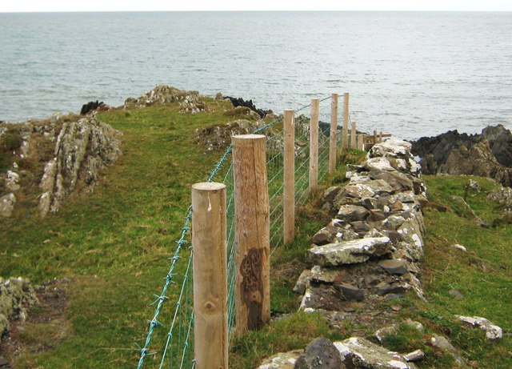

Notes:
Is it better to have a fence a the top of the cliff or a hospital at the bottom
Prevent or treat?
Could mistake been prevented check list
Double check?
Error handling?
Using a process?
Taking your time – CCT does not deploy ANY changes on a Friday

Slide 30
Step 5

Slide 31
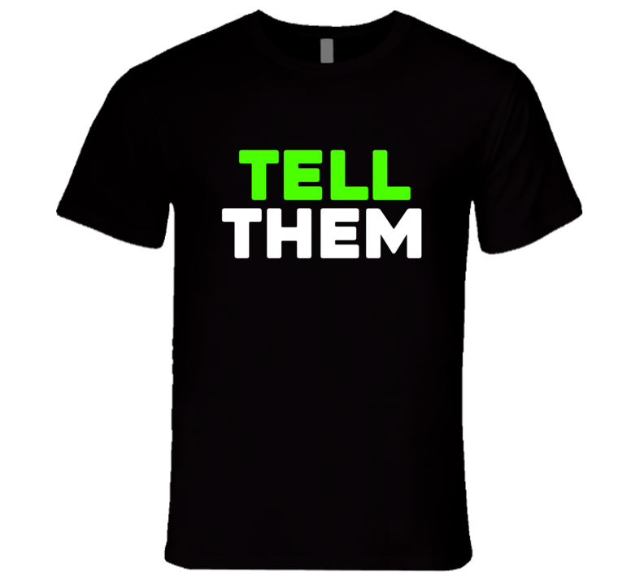
Notes:
Once I am confident that I understand the issue
A solution has been found
Next is to explain the
Mistake – what happened
How – resolved it
What doing to prevent It

Slide 32
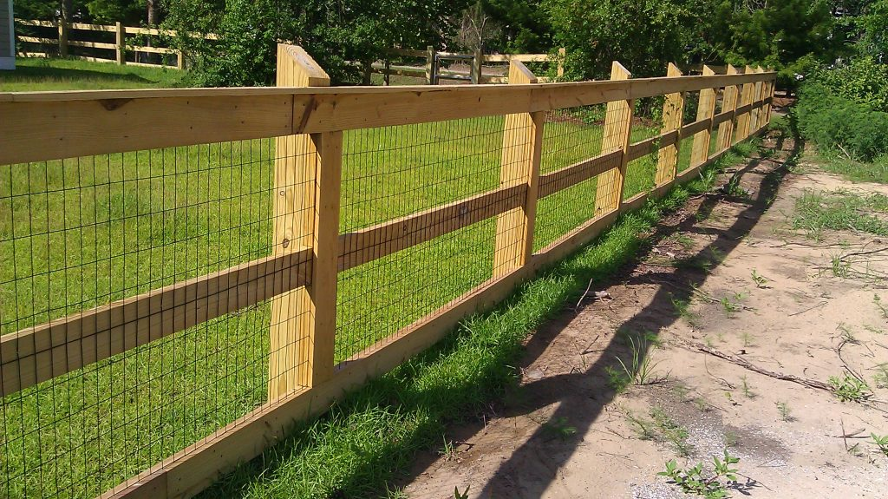

Slide 33
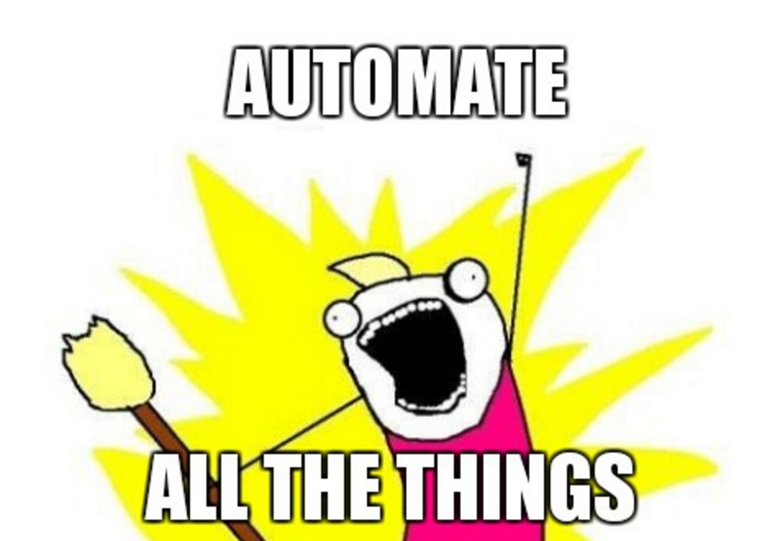

Green is Good Red is Bad
Turning Your Checklists into Pester Tests
See @sqldbawithbeard ->
Notes:
Rob Sewell is here at SQLGrillen

Slide 34
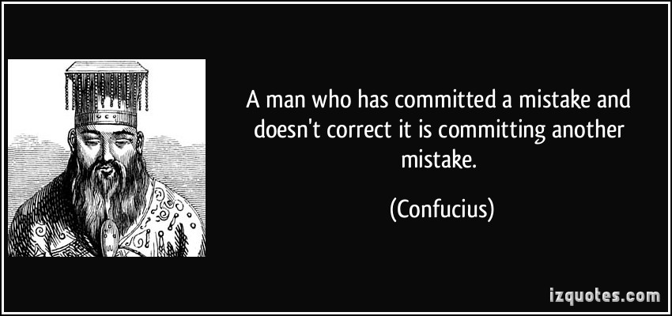

Slide 35


Slide 36
Success is not measured by how you got it right the first try but how many times you were willing to
try again.
Jamie McAllister
Notes:
17 MINS

Slide 37

Bualadubh – North Uist Nov 2014
2 - Apologies

Slide 38
Apologise Verb -
express regret for a wrong that has been done ;
fault, insult, failure, or injury:

Slide 39

Guidelines
Not Rules
Notes:
Apologies these are guidelines not rules

Slide 40

Notes:
It can and does help to repair breaks in relationships or even broken relationship

Slide 41
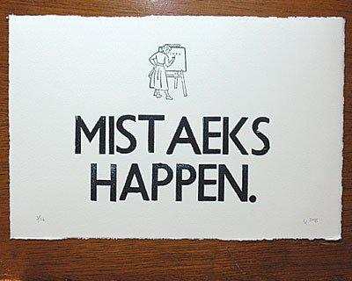
Notes:
http://www.powerpoetry.org/poems/everyone-makes-mistakes
We all make mistakes do things wrong that we recognize later

Slide 42

Notes:
https://www.therainmakerblog.com/2014/09/articles/law-firm-marketing/how-to-build-trust-online-by-being-human/
By making an apology you help to rebuild trust

Slide 43
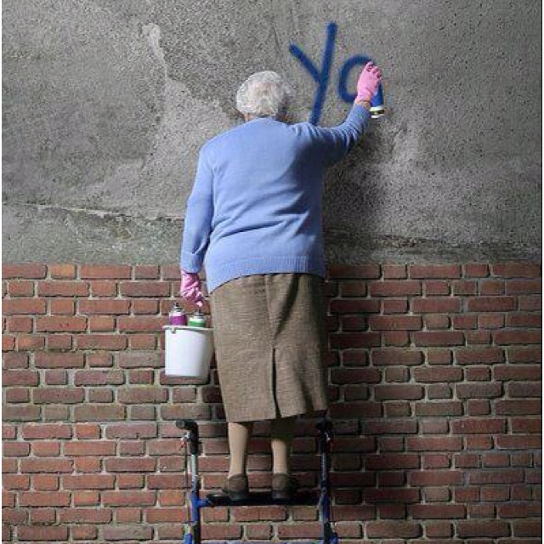
Notes:
Shows you are mature and responsible person and open

Slide 44


Slide 45


Slide 46

Notes:
Be clear as to what you are apologising about

Slide 47
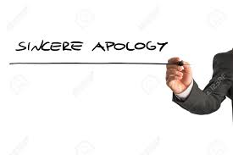
Notes:
Sincere – heartfelt

Slide 48

Notes:
Say sorry - express remorse
Acknowledge you have done something wrong

Slide 49

Notes:
Say and take action so does not happen again

Slide 50

Notes:
YWAM – story Hong Kong
Say it on twitter not in DM – then public
Email should email everyone involved

Slide 51
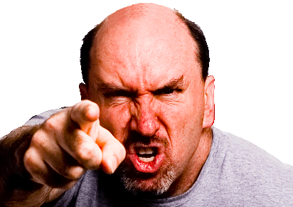
Notes:
Apologies in company context
Customer who came to complaint NTL head end which was in the middle of an industrial estate !!!

Slide 52
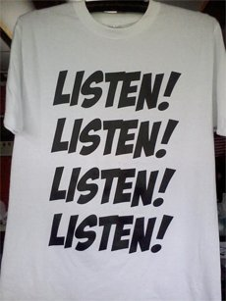

Slide 53
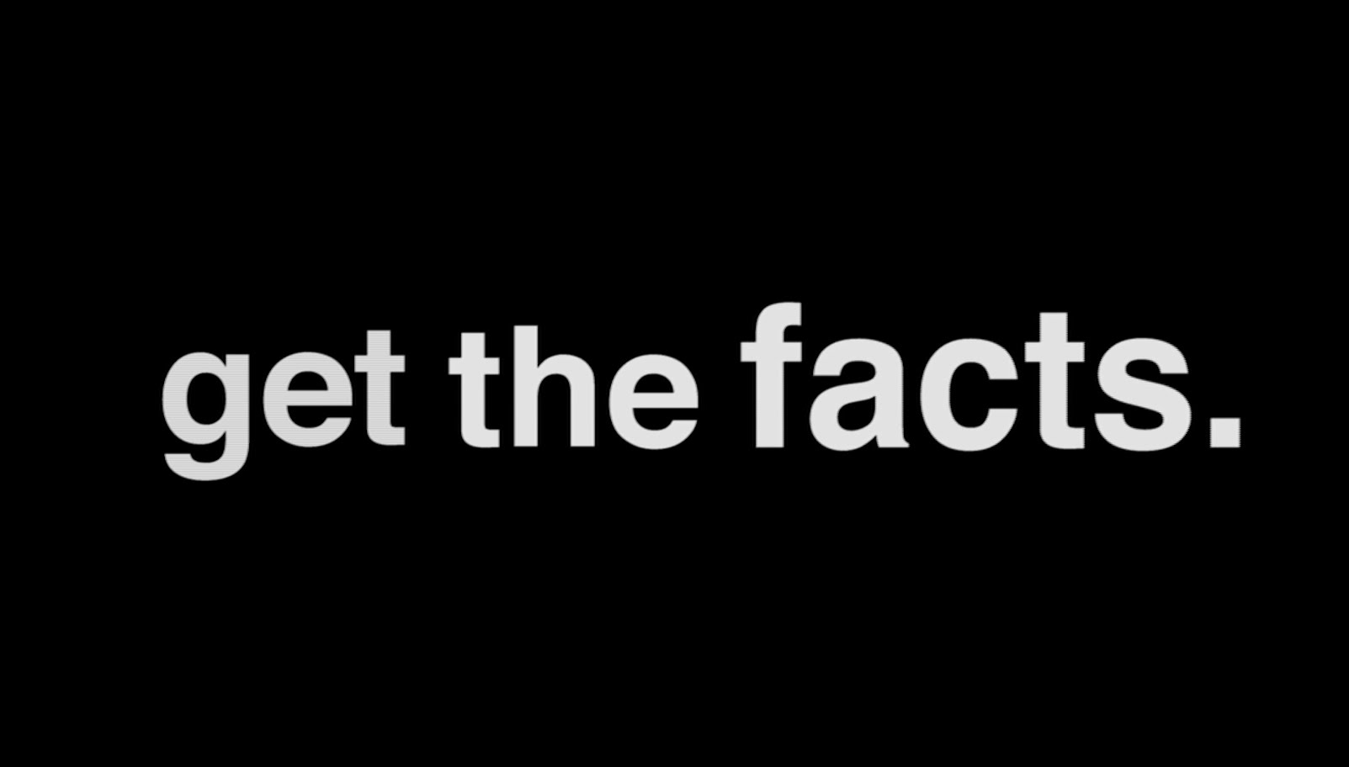

Slide 54

Check the facts

Slide 55

Notes:
Acknowledge how the customers feels
If I was in your situation I would feel the same way

Slide 56


Slide 57

Notes:
Agreed goal

Slide 58

Notes:
17 MINS

Slide 59

http://taighdobhrain.co.uk
3 -Mind your language

Slide 60
Achte auf deine Sprache
Surveille ton langage
Mind your language
vårda ditt språk
pass på språket ditt
Notes:
Be careful about the words that we use
They are very powerful and we should be careful with them

Slide 61

https://nuwritersguild.files.wordpress.com/2015/01/hands.jpg
Notes:
The words we use when speaking to people can bring us in and make us feel part of something
Make us feel inclusive
Make us feel included

Slide 62

https://medicalxpress.com/news/2015-12-children-exclude-otherhelping-kids-left.html
Notes:
Words can also exclude us from groups, and conversations, what does it feel like when visit foreign country unable to speak the language?
Make us feel excluded
Make us feel included

Slide 63
“What do you do?”
My reply
“My primary role is a BI Developer working with the Microsoft BI stack. Specialising in SSRS report development, working to develop POC with PowerBI. I also work with SSIS having maintained and developed a number ETL packages for various reporting projects………….”
Notes:
When asked what do I do, this would be my standard reply to most people, including my non-technical family

Slide 64
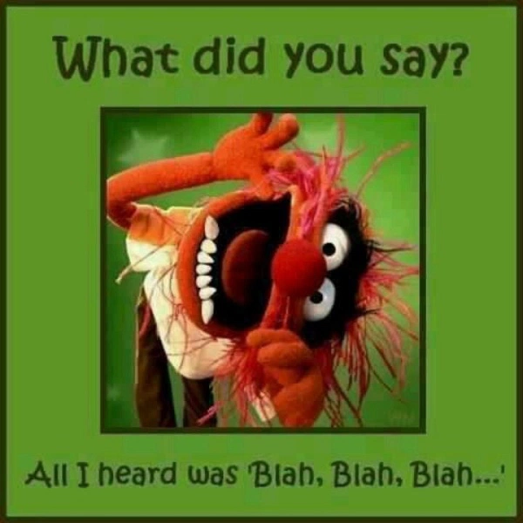
Notes:
What did they hear?

Slide 65
Now my reply is
“Mainly I do three things”
Data Shepherding
Data Grooming
Teach Data To Dance
Notes:
Now my reply is
“Mainly I do three things”
Data Shepherding
Data Grooming
Teach Data To Dance
This is what’s on my linked in profile!!!

Slide 66
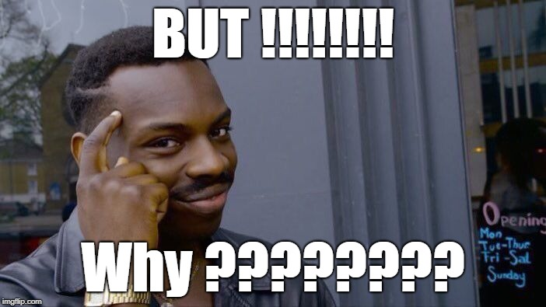
Notes:
That is a VERY good question
Use words most people understand and can relate to

Slide 67

I.T.
Acronym’s

Slide 68
Acronym’s
acronym is a word or name formed as an abbreviation
Examples
UN
United Nations
BBC
British Broadcasting Corporation

Slide 69

Guess the acronym

Slide 70
HTML
Hyper Text Mark up Language
ETA
Estimated Time of Arrival

Slide 71
SSIS
Sequence Stratigraphic Interpretation System
http://doc.opendtect.org/6.0.0/doc/dgb_userdoc/Default.htm#sequence_stratigraphic_interpretation_system.htm
Standard Settlement InstructionS
https://www.natwestmarkets.com/natwest-markets/Changes-to-our-payment-details/SSI-customer-information.htm
SSAS
Ship Security Alert System
https://en.wikipedia.org/wiki/Ship_Security_Alert_System
Notes:
Yes I am deliberate messing with in the answers

Slide 72
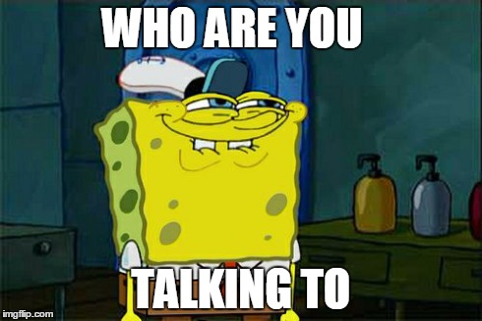
Notes:
I SUGGEST that you think about those people you are speaking to

Slide 73


Technical?
Non – Technical ? Business user?

Slide 74
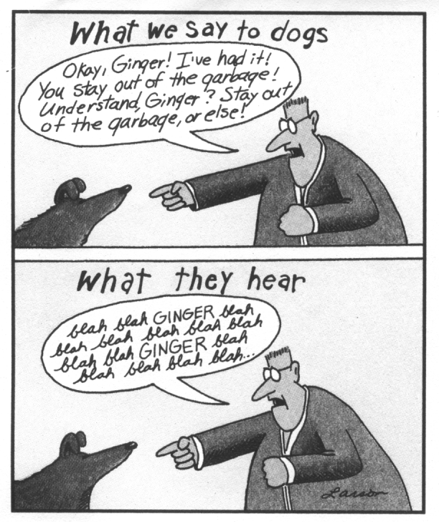
Notes:
Most people think the words we use they understand them

Slide 75
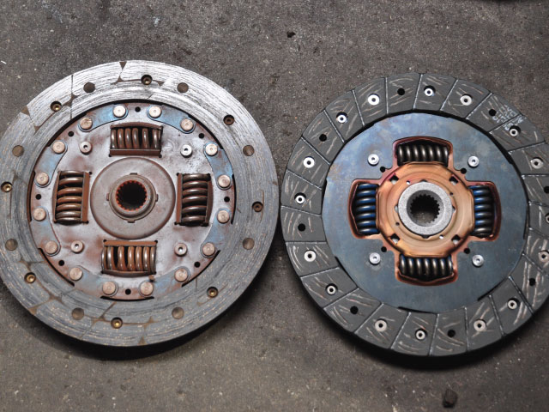

Slide 76
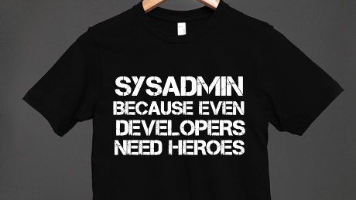
Notes:
When speaking to Jamie (SysAdmin) make sure I explain clearly what I want. He is responsible for changes to our production databases, not dba or dev

Slide 77

https://www.discogs.com/Various-Scratch-The-Itch/release/536925
Notes:
Scratch the itch
Address the what they need or wanting from me

Slide 78

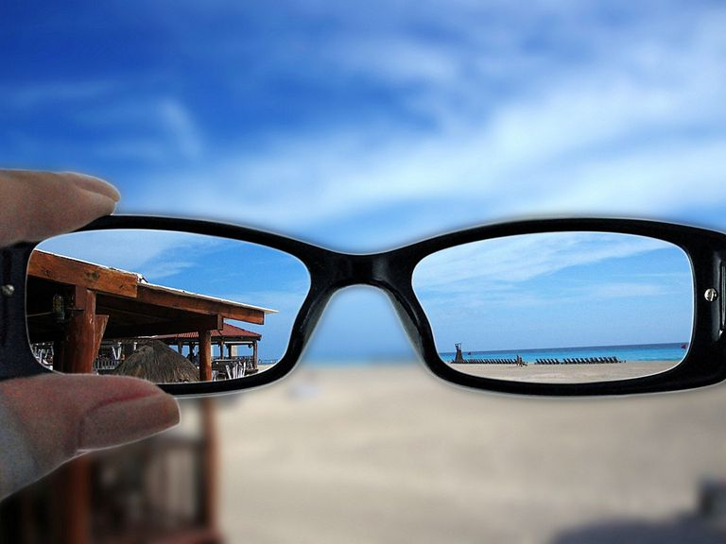



Slide 79


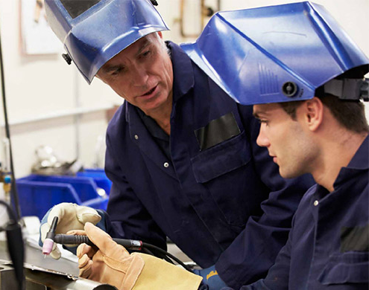

Notes:
Why – Give them a reason why to do it – benefits of doing, or dangers of not doing

Slide 80
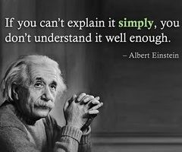
Notes:
27 MINS

Slide 81

http://tighalasdair.co.uk
4 - Listening

Slide 82
Listening

Slide 83
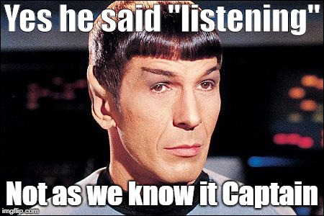

Slide 84
Hearing
vs
(Active) Listening

Slide 85

Hearing
Notes:
Listen is just acknowledging the sound of the words
There is no action take the words are just heard

Slide 86

Listening
Notes:
Listening requires to hear the words and sentences. Picking out what the speaker is saying. This requires use of your mind, its active and requires work on the part of the listener.

Slide 87
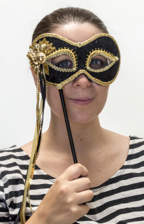
Notes:
Active listening can help us hear what people really mean
Rather than what people often want us to hear or see

Slide 88
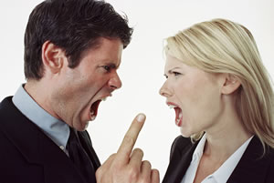
Notes:
Conflicts can also be resolved if we are willing to listen to what the other person is saying

Slide 89
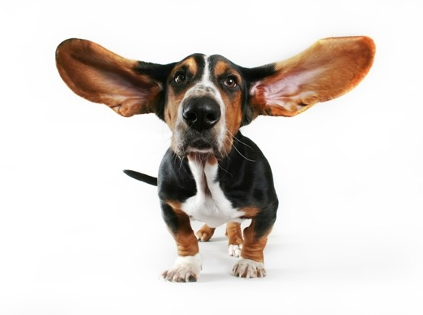
You were born with two ears
and one mouth for a reason
Epictetus

Slide 90
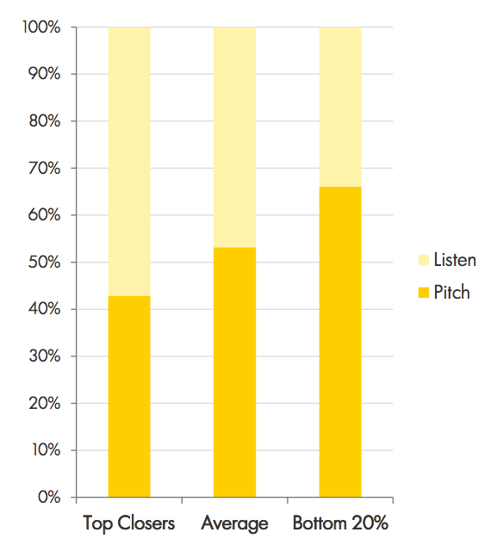
The golden ratio
https://www.saleshacker.com/sales-ratio-talk-vs-listening/
Notes:
Sales all talking and no listening?
Study showed very different picture, top sales people listened more and talked less
Golden ration – 2 ears and one mouth, so listen twice as much as you talk

Slide 91
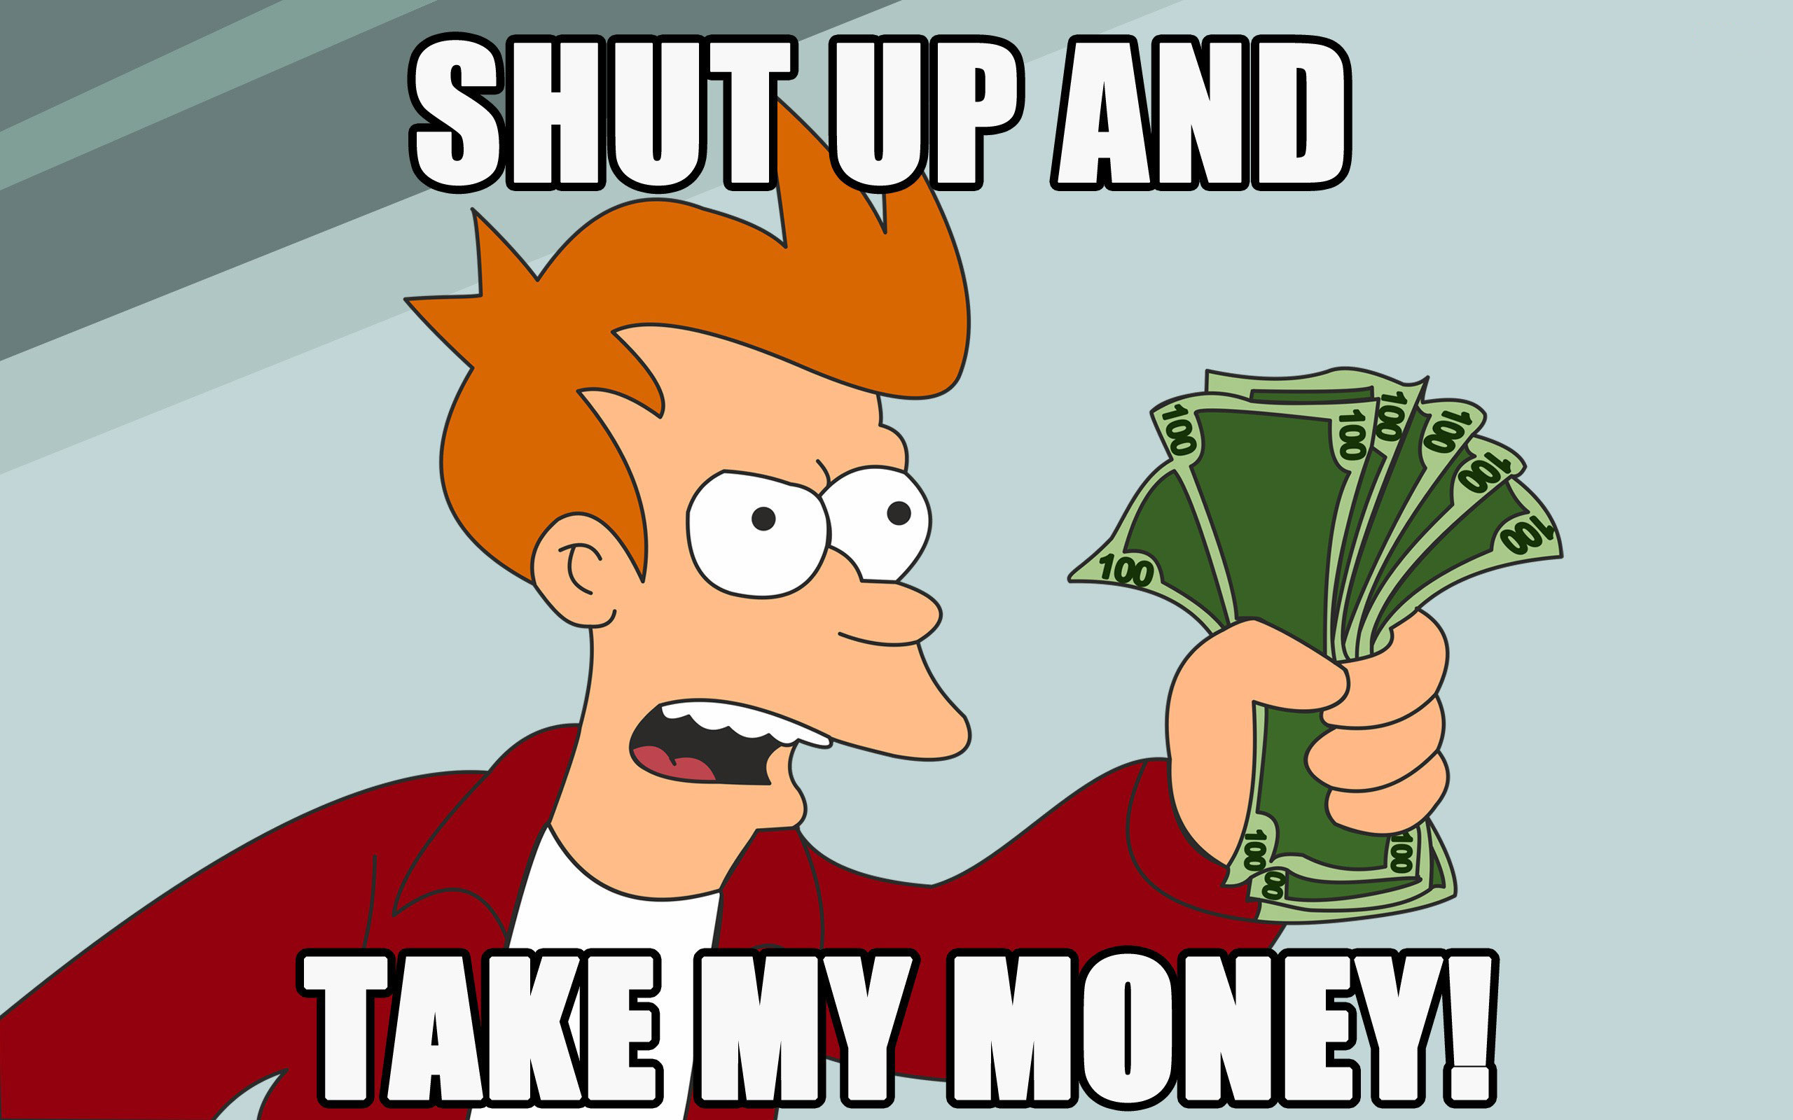

Slide 92
Some tips
(guidelines not rules)
Notes:
These are tips and hints, this takes practice

Slide 93

Notes:
Easy to say you are “listening”
Show you are “listening” is far more effective though

Slide 94

Notes:
Face the person you are listening
Make eye contact
Put away distractions if you end up playing with them
Smile it really helps
Make sure you body language is open, are you arms and / or legs crossed? Are you constantly looking down? (looking at notes is ok just not all the time)

Slide 95
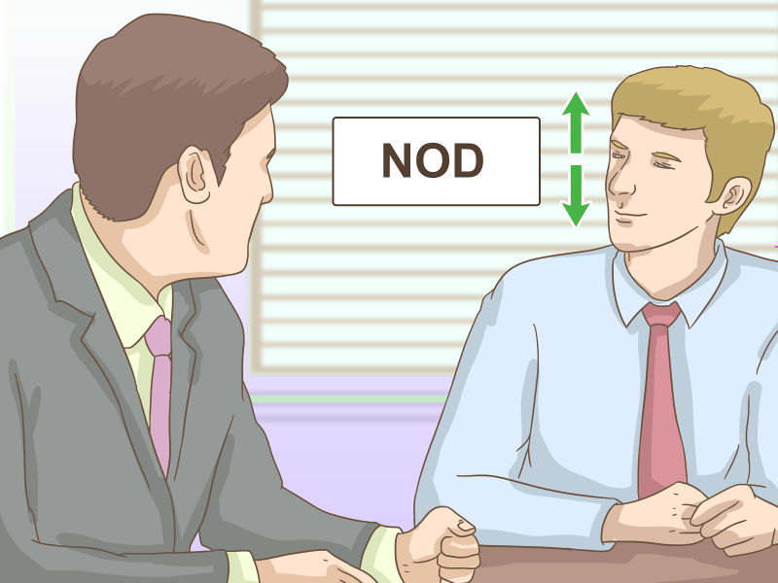
Notes:
Nodding your head just once in a while

Slide 96
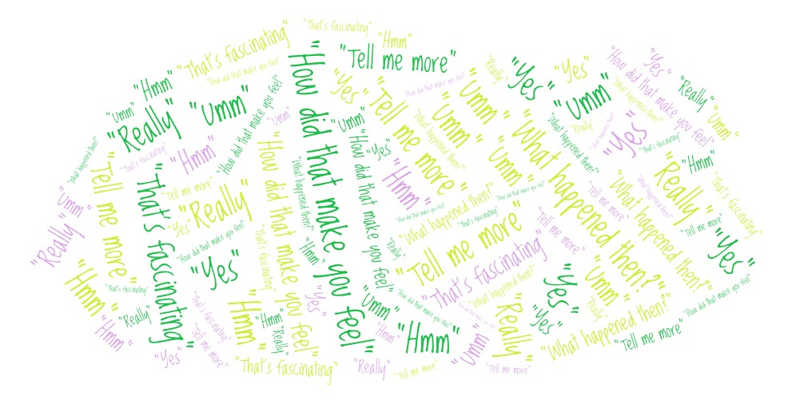
Notes:
Encourage the listener with words and phrases
"Yes" "Really" "Tell me more" "What happened then?" "hmm" "That's fascinating" "how did that make you feel“
Use words and phrase you feel comfortable, remember practice makes prefect

Slide 97
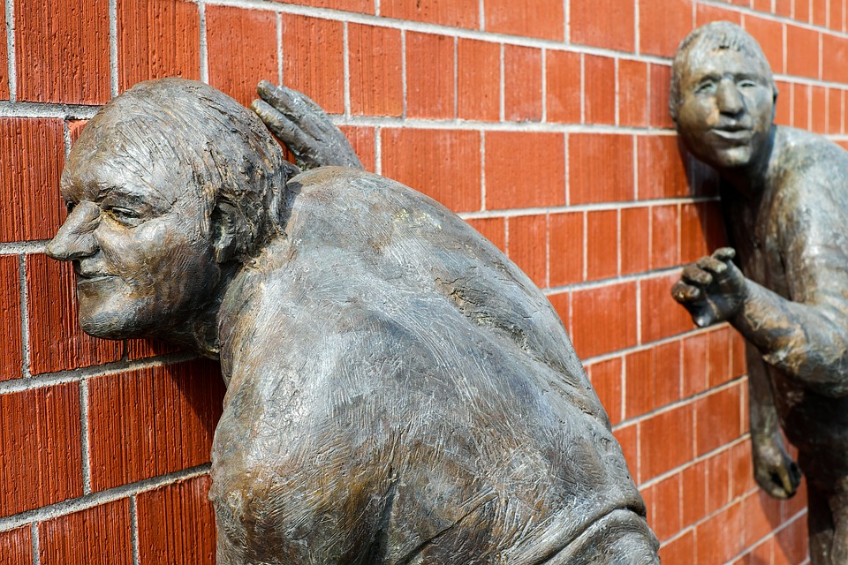
Notes:
Pay attention to the speaker
Listen to what they are saying
Not just the words
How are they spoken, pauses, how are the words used, what sentences
ASK QUESTIONS if you do not understand, not like an interrogation

Slide 98
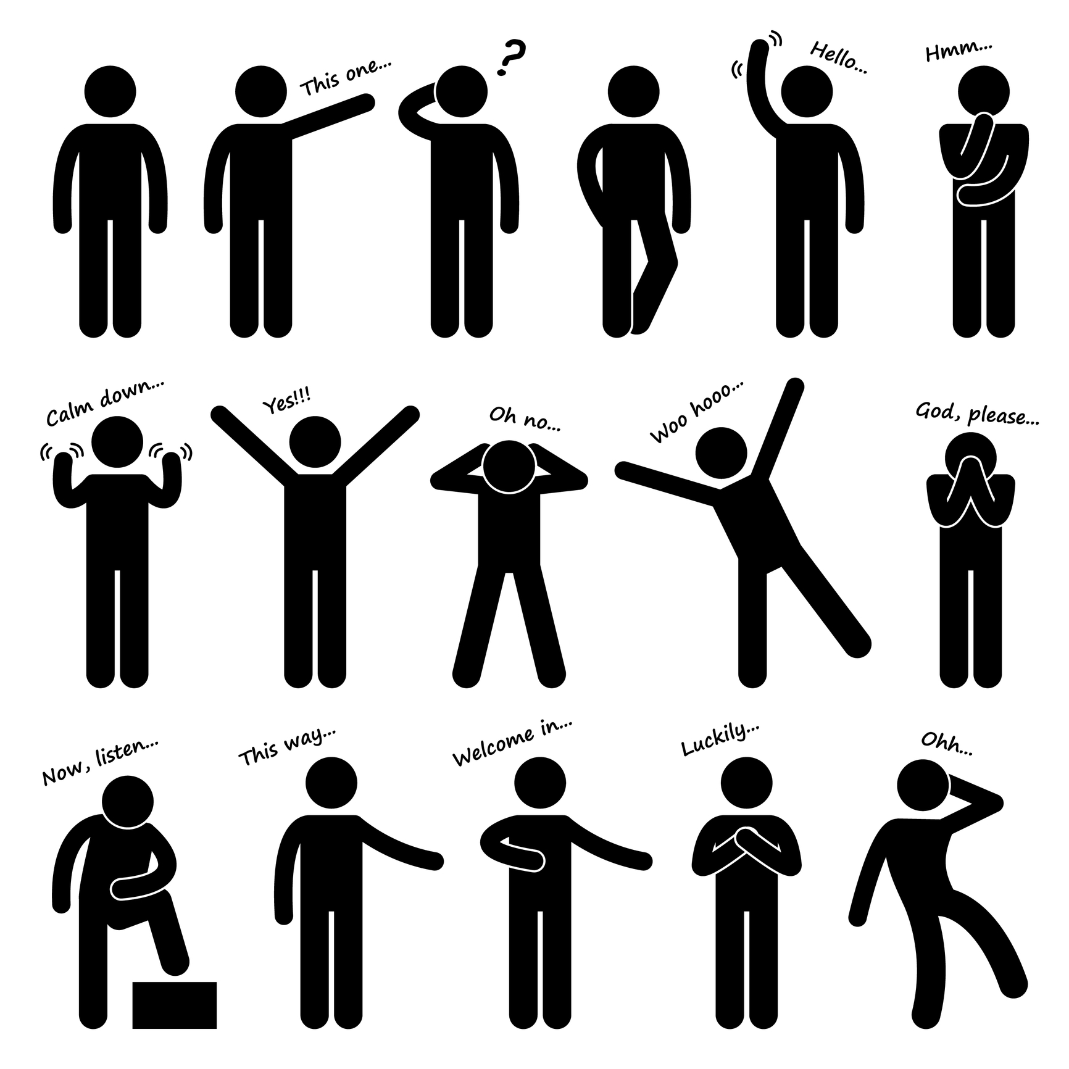
Notes:
Body language is what we do not say it often shows what we really mean

Slide 99
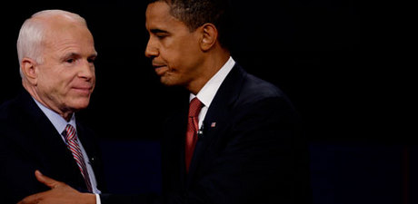
Notes:
If no or little eye contact ask yourself why
Nervous?
Something do not want to say
Something to hide
CONTEXT !!!!!

Slide 100
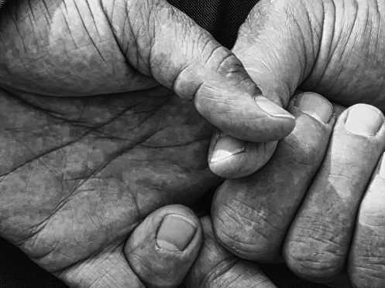
© Mark Spearman/Flickr
Notes:
Fidgeting demonstrates nervousness and a lack of power, as body-language expert and "The Power of Body Language" author Tonya Reiman previously told Business Insider.

Slide 101

Notes:
Playing with ear can indicate trying someone trying to make
a decision about something

Slide 102

Marocomassarotto / Flickr
Notes:
The person you are speaking to are they slow or fast when speaking
Quickly with excitement and enthusiasm
Carefully, thoughtfully, slowly
Is the subject they are speaking about appropriate

Slide 103

Notes:
If you are not sure ask questions
This shows you are interested in what was said
37 MINS

Slide 104

5 – Pass it on

Slide 105
Pass it on
Notes:
What do I mean by this?
Knowledge sharing

Slide 106
Warum?
Notes:
Why –should you share your hard earned knowledge and expertise?
You earned, gathered it over time its all yours

Slide 107
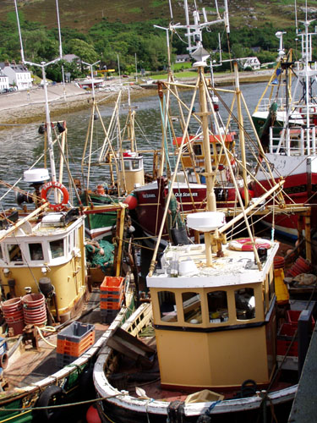
Notes:
A rising tide raises all ships – passing on your knowledge can help everyone around you

Slide 108
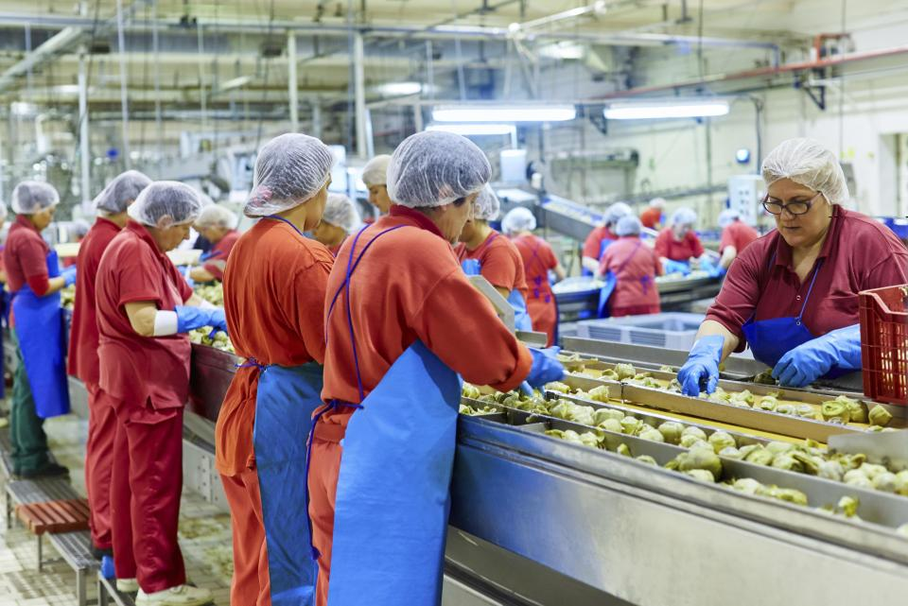
Notes:
Do you want to do the same thing day in day out
Pass on your knowledge, pass it to team members you will be recognised as the person passing on knowledge
Jim comment (SAIC) those who pass knowledge on are those who are recognised as the person to give new tasks to

Slide 109

Notes:
Sharing knowledge helps to build teams.
Might sound like teaching yourself out a job
If I managed a team want someone who shares

Slide 110
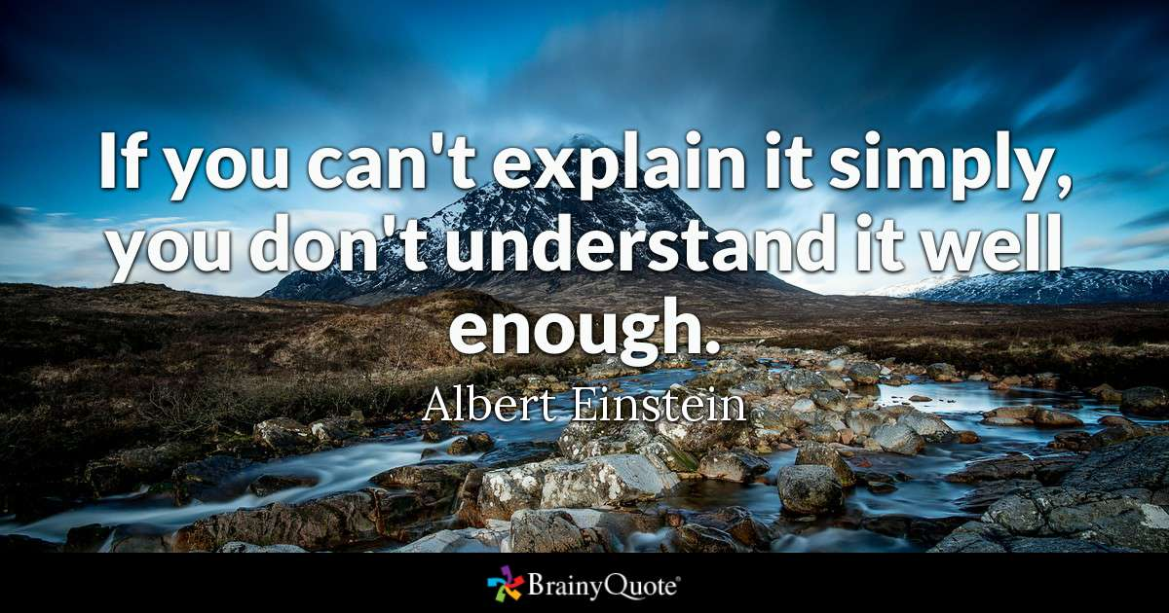
Notes:
Teaching forces me to understand things
Often I learn more from teach others than I think other people do

Slide 111

Notes:
Passing on knowledge can help you build your brand
Maybe you have heard of
Grant Fritchly
Brent Ozar ?
Pinal Dave ?
Araon Bertand ?
Catherine Wilhelsmsen?
Rob Sewell ?
William Durkin?
Steve Jones

Slide 112

Notes:
Pay back the technical debt
Not sure about you my career is based on some many blogs and other sessions
Where others have given freely of their time, and expertise

Slide 113

Notes:
From my point of view, I know that I benefit more for teaching than those that I teach
Often greater understanding of the topic
Recent recursive CTE example

Slide 114
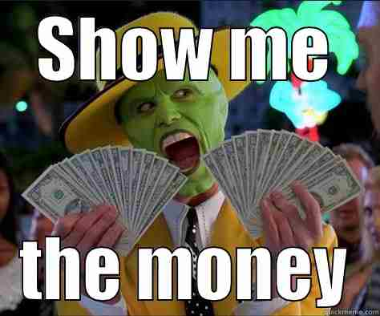

Slide 115
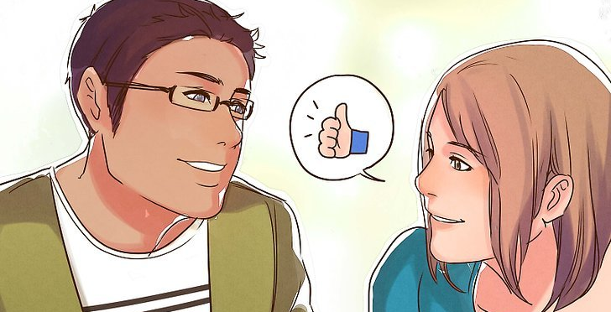
Notes:
Be approachable
Are you the person people come to ask for help?
Are you grumpy when people ask you questions?
Do you make people feel good when they ask you a question

Slide 116
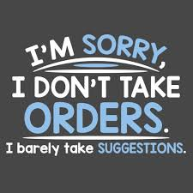
Notes:
The approach I take is to make suggestions. Often saying “this is how I would approach this issue”
If we are someone line manager yes the situation might be different

Slide 117


Slide 118
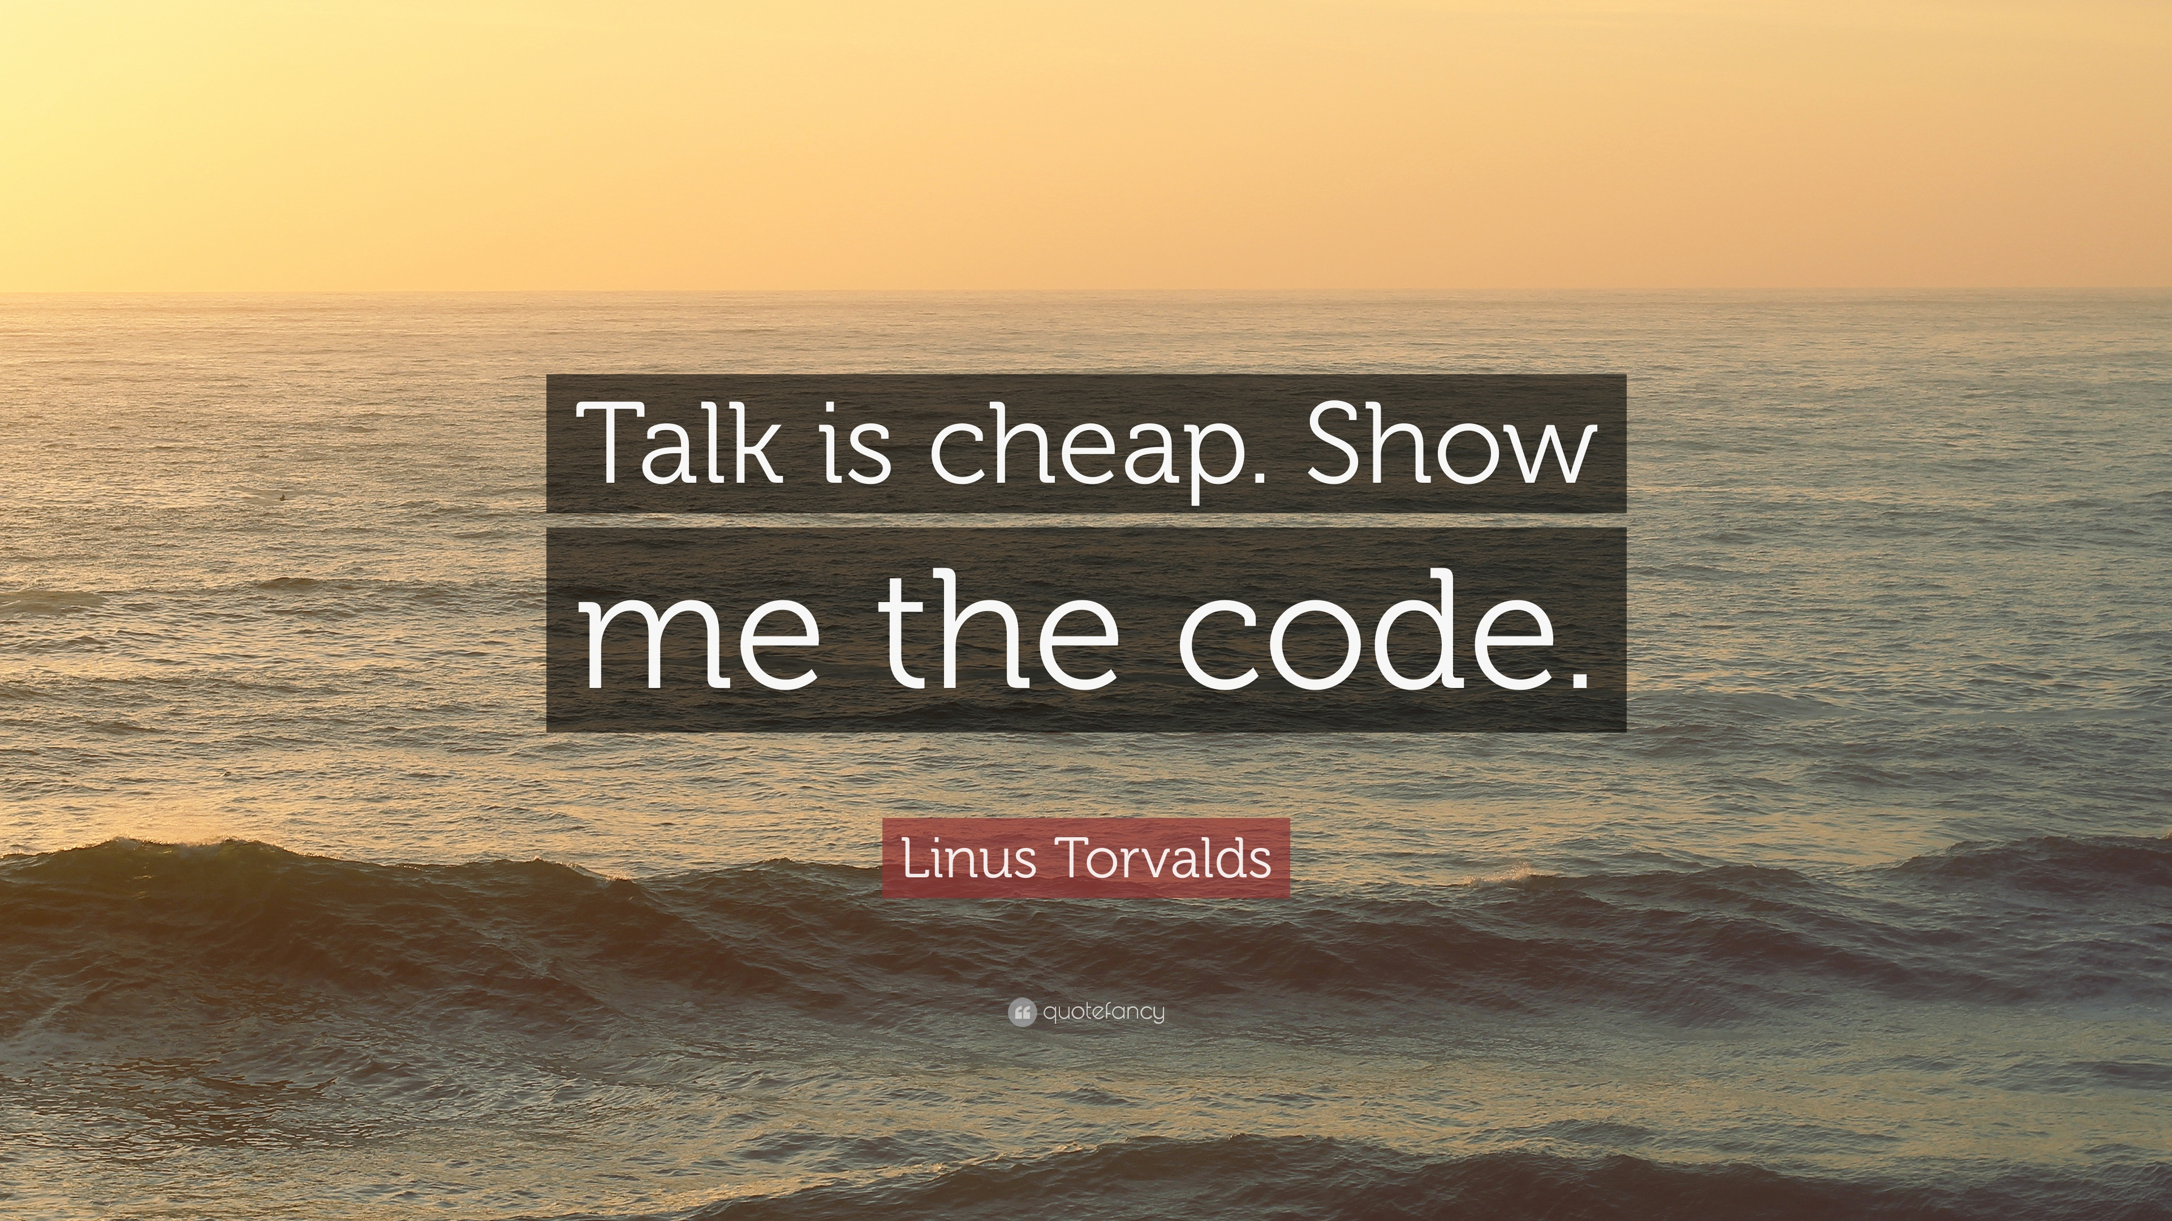
Notes:
When showing people if at all possible I start writing the code
Showing what how when and were to make the changes

Slide 119
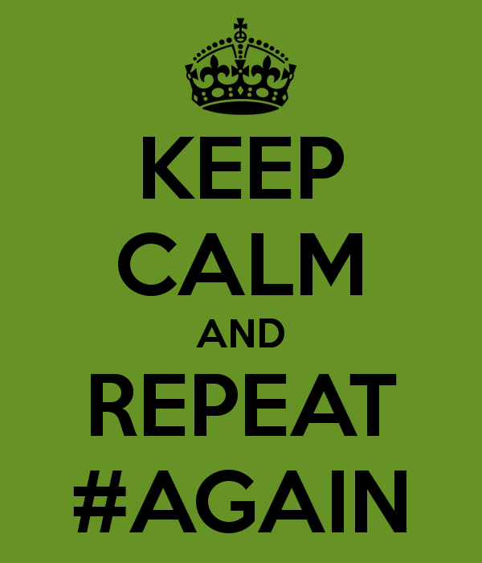
Notes:
Even if said it before happy to repeat and repeat and repeat and repeat
They might always get it first time around
Do not always wait for person to ask – so often use phrase “for my benefit let me repeat that again, to ensure I have not missed anything” That way it looks like its for me benefit I get to confirm I’ve not missed anything I meant to say, the other person gets to hear again they can check they have not missed anything
Win-Win for both sides

Slide 120
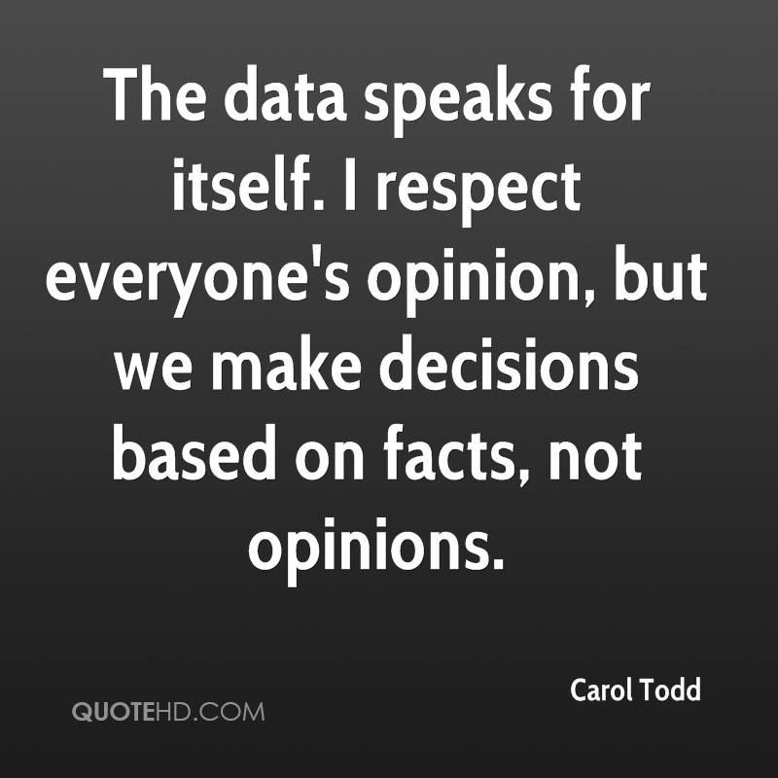
Notes:
When working with developers what I try to do is work with facts give them facts
Speed between different types of SELECT for example
My preference Is to use
Set Statistics Time on & Set Statistics IO On – Yes have to explain we can all see the stats though !

Slide 121

Notes:
Are you prepared to learn
Marcin story of showing me the edit top 200 rows trick
The best teachers I have met are the ones who are open to learning
They do not say “I know it all” – they are approachable!!!!!!

Slide 122

Notes:
At my current company recognised lack of sql skills, based on questions and interactions
So volunteered to do a training course on SQL
SCARY !!!!!!
The upside is I have learned FAR more than my fellow colleagues
47 MINS

Slide 123

Benbecula beach north Uist
6 – Compliments

Slide 124
Compliment
a remark that expresses approval, admiration, or respect:
Notes:
Lets start off defining it
We all know when we hear one, or even better when we get one

Slide 125

Notes:
This is a very fair question
There is no reason why we should do something unless we know what getting out it

Slide 126
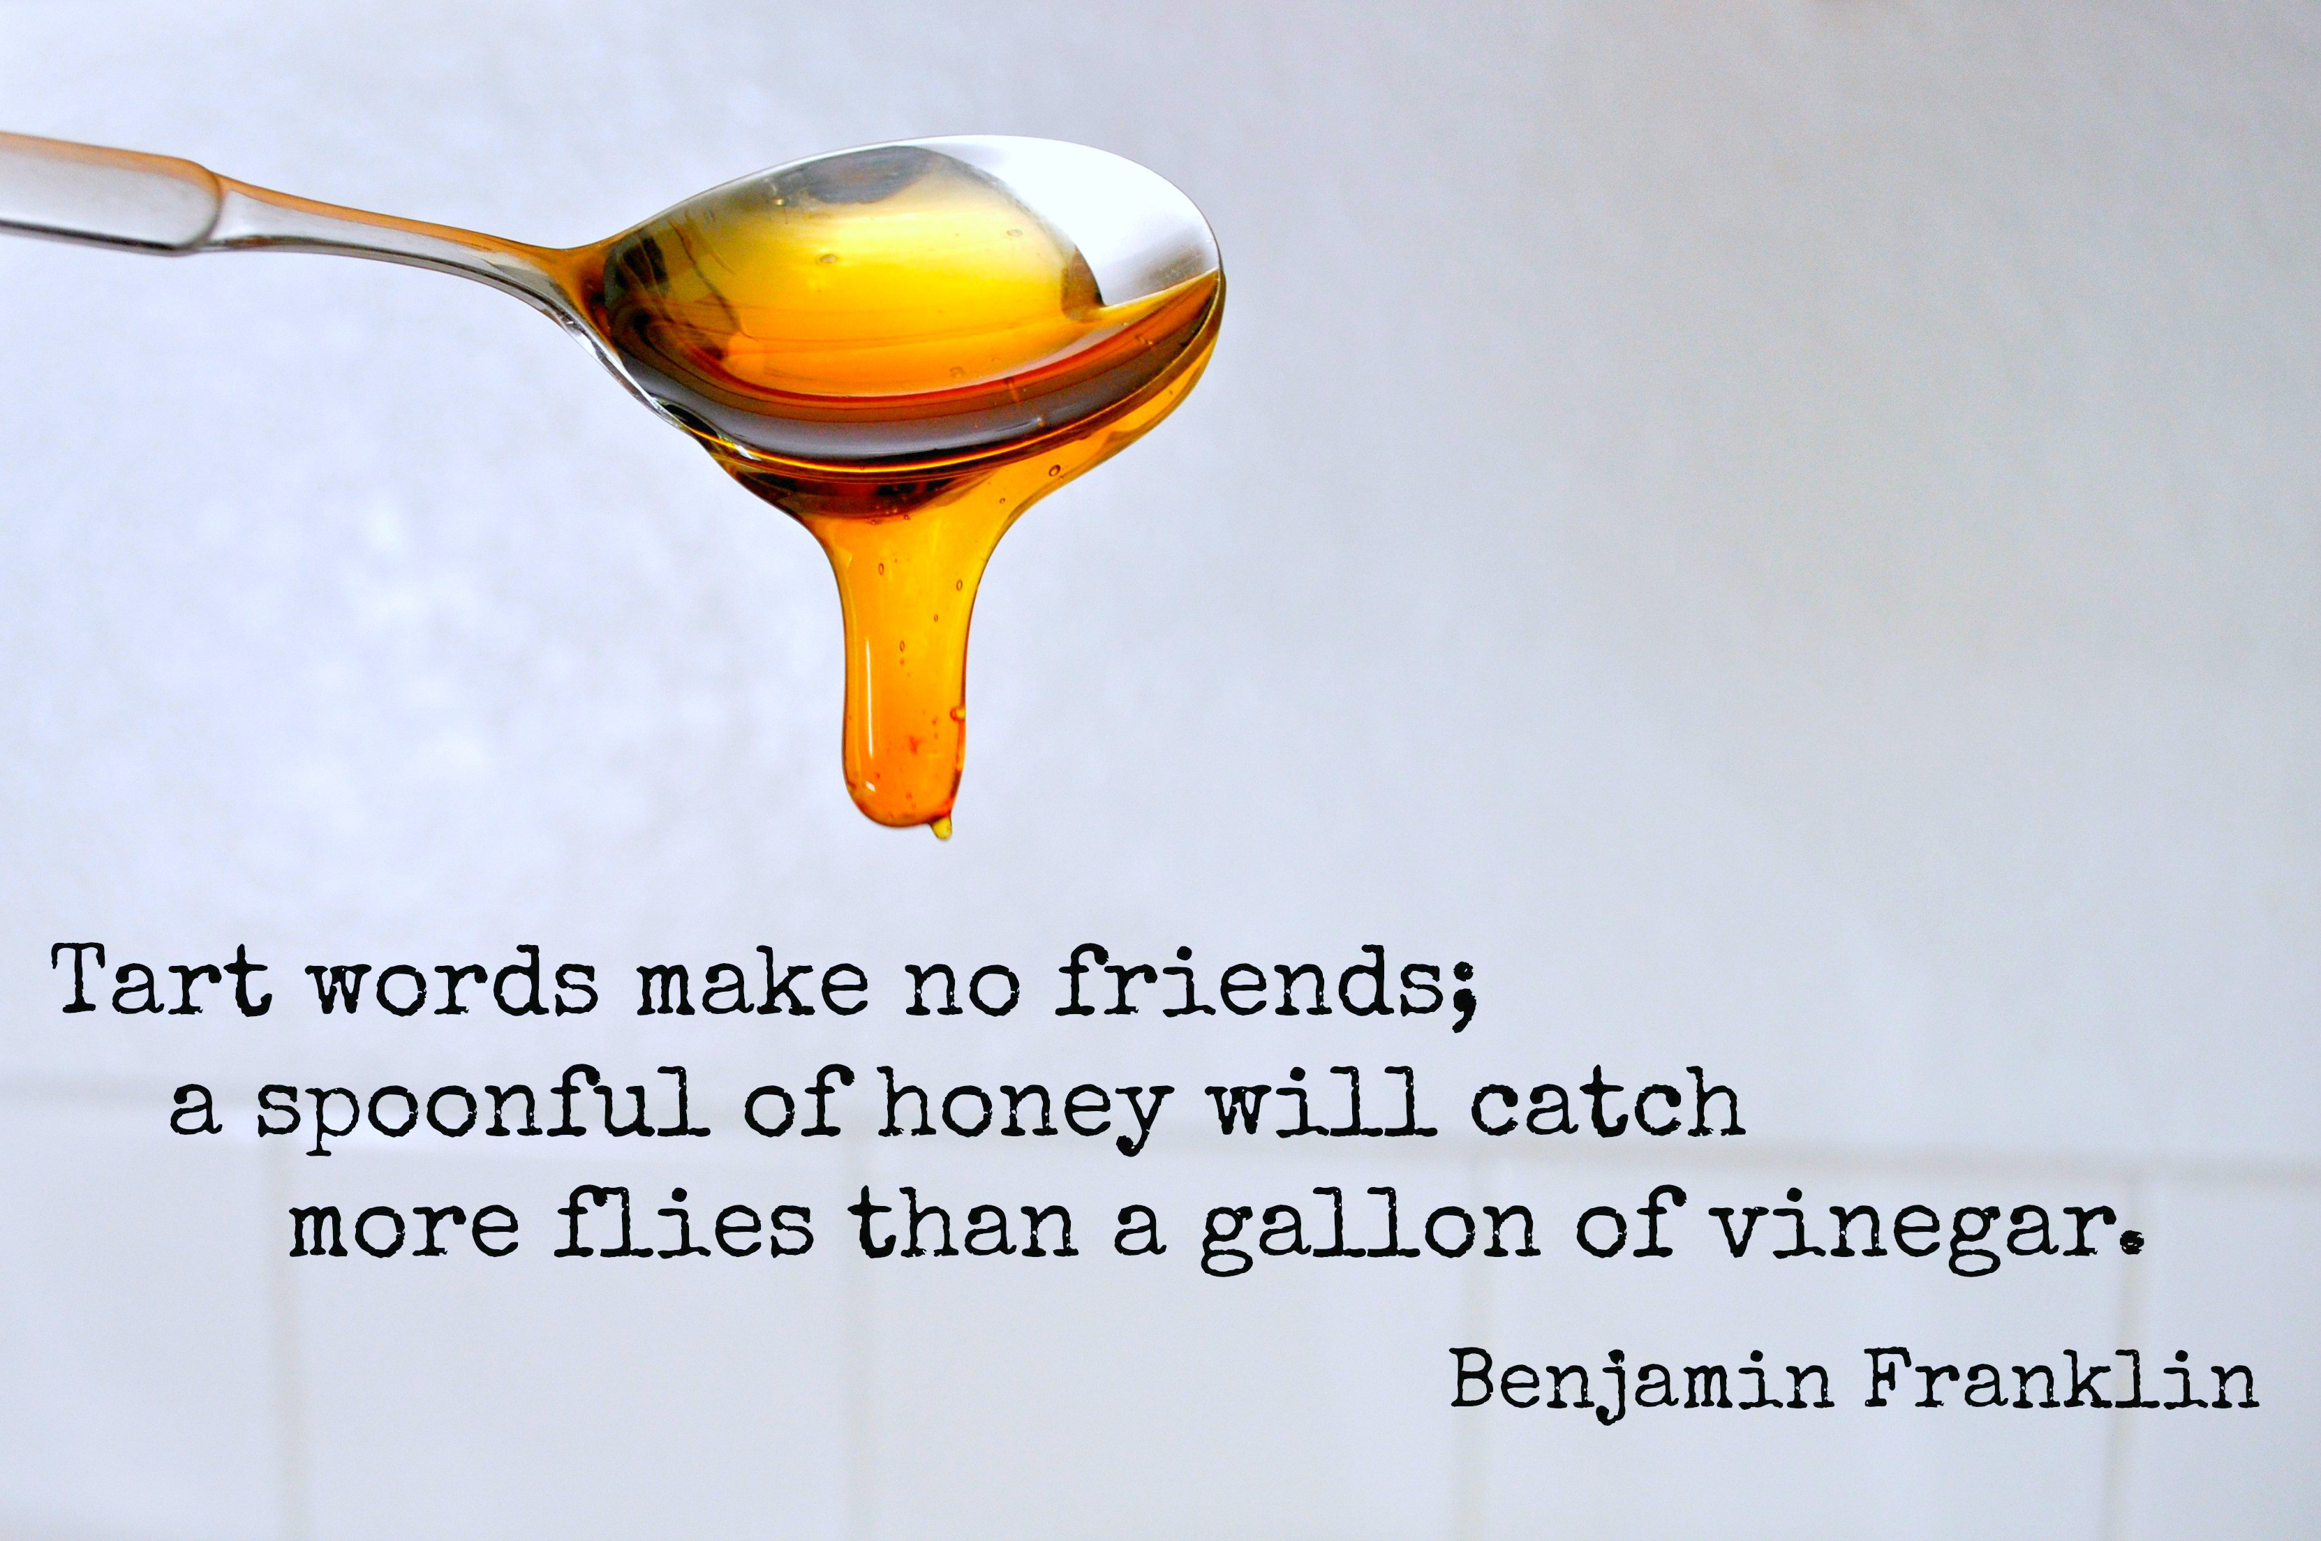

Slide 127

Notes:
What do compliments for others

Slide 128

Notes:
Compliments put focus on other person
Not on your person giving the compliment
Question – who are people most interested in?
Answer – themselves !!!
No convicted – who do think is usual right in an argument ?
Who’s opinion matters the most in a conversation ?

Slide 129

Source
Notes:
Compliments can boost peoples self

Slide 130

Notes:
As the giver of compliments you are seen by other people in a very different light
That Is a much more positive light

Slide 131

Notes:
Maybe some people do not believe me yet?

Slide 132

Notes:
Think about a compliment you received
How did it make you feel?
How did feel for the next couple of minutes / hour/ day

Slide 133

Source – flickr.com
Notes:
It does and can make a difference to how you feel

Slide 134
Do
It
Yourself
Notes:
Now I’ve told you why you should do it
Let me talk about some of things I do

Slide 135

Notes:
How not to give compliements

Slide 136

Grandparent test
Notes:
One thing to think about before giving a compliment would you free ok giving same compliment to your Grandfather or Grandmother
If not then chances are its probably not a good idea
If in doubt do not do it

Slide 137
You’re pretty good at programming
for a ……………

Slide 138

That’s a good query for someone who does not know X

Slide 139


Notes:
When appropriate I will make eye contact and smile at someone when I give a compliment
They know its directed a them
2) My focus is on them

Slide 140

Notes:
Be specific with the compliment not general
Not “you look nice”
Compliment something they have rather than physical appearance unless you other half which is very different
Did they complete a physical task ?
Did they do something well eg tackling a difficult technical challenging

Slide 141

Be genuine
Notes:
If you see something that you feel should be complemented
Do not wait make the complement

Slide 142

Notes:
Use peoples name, especially if you do not know them
Peoples names are very powerful your compliment is directed at THEM

Slide 143


Slide 144

Notes:
Be on the look out for things to compliment
The more you look for them the easier it is to find them

Slide 145

Notes:
If you heard a compliment 2nd hand
PASS IT ON, you get the credit and the recipient feels good
Win – Win situation

Slide 146


Slide 147
Have you complimented your manager?

Slide 148


Notes:
Compliment waiting staff story about two restaurants in Oban
Robin and chefs at Gleneagles

Slide 149



Notes:
Seen any good speakers at a conference that made a difference
Tell them – I do it so good to know that your session went down well
Or just that one person got something from it
Just not me ☺

Slide 150


Slide 151

Will the other person feel good?
Notes:
If you comment does not make the other person feel better do not say it
We all need to learn to accept compliments graciously

Slide 152


Slide 153
Notes:
Mistakes – will happen I have plan to learn from them
Apologies - are not easy but they are worth it

Slide 154
Notes:
Mind your language – words are powerful, I think about what l am saying and to who
Listening – is something active, I try to work at everyday

Slide 155
Notes:
Pass it on – knowledge transfer helps to build teams, and can help to
Compliments – raise people up, make them feel good

Slide 156
one point
Notes:
My aim with the this presentation is for you to take just one point away from the session

Slide 157

If you want to go fast, Go alone
If you want to go far
Go together
Photo by Kevin Delvecchio on Unsplash
Notes:
Soft skills are a journey not a destination

Slide 158
Robert French
Consultant with CC Technology
In Sunny Glasgow Scotland
rwlp.french@gmail.com
@sql_bob
https://www.linkedin.com/in/rwlpfrench/
http://www.sqlbob.uk/

Slide 159
Success is not measured in the amount of dollars you make,
but the amount of lives you impact.
Lewis Howes

